Slide 1
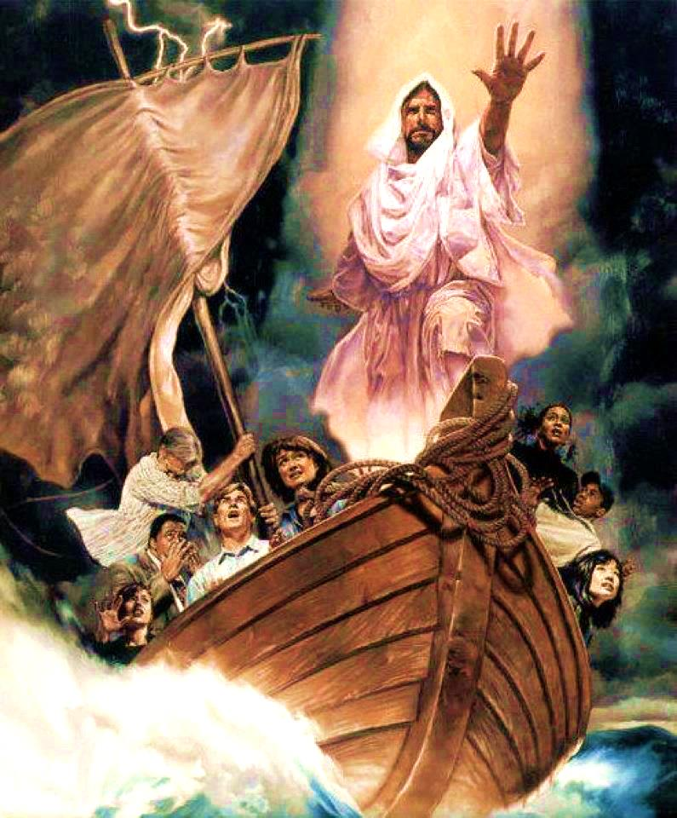
What Kind of Man is This?

Slide 2
Note: Any videos in this presentation will only play online. After you download the slideshow, you will need to also download the videos from YouTube & add them back into your PowerPoint.
We present these messages at Bee Creek Park in College Station, TX. If you would like to watch the video of the service with this message, click here:
http://campaignkerusso.org/?p=11349
We would love to know more about the people who download our lessons & sermons. We invite you to email us & let us know where & how you use them.
info@ckbrazos.org

Slide 3
What Kind of Man is This?

Slide 4
9And now, behold, the cry of the people of Israel has come to me, and I have also seen the oppression with which the Egyptians oppress them.
10Come, I will send you to Pharaoh that you may bring my people, the children of Israel, out of Egypt.”
11But Moses said to God, “Who am I that I should go to Pharaoh and bring the children of Israel out of Egypt?”
God chooses Moses to free the Israelites from Egypt

Slide 5
12He said, “But I will be with you, and this shall be the sign for you, that I have sent you: when you have brought the people out of Egypt, you shall serve God on this mountain.”
13Then Moses said to God, “If I come to the people of Israel and say to them, ‘The God of your fathers has sent me to you,’ and they ask me, ‘What is his name?’ what shall I say to them?”
14God said to Moses, “I AM who I AM.” And he said, “Say this to the people of Israel,
‘I AM has sent me to you.’”

Slide 6
Next Slide - Song:
He is the great I AM →
Download Here:
http://youtu.be/t9MWbIEKus0

Slide 7
Matthew 12:6
..”One greater than the Temple is here”
Matthew 12:41
..”One greater than Jonah is here”
Matthew 12:42
..”One greater than Solomon is here”

Slide 8
Matthew 12:6
...”One greater than the Temple is here”

Slide 9
Next Slide - Video:
Matthew 12:6→
Download Here:
http://youtu.be/jdIsTgJqJD4

Slide 10
Matthew 12:41
..”One greater than Jonah is here”

Slide 11
Next Slide - Video:
Matthew 12:41→
Download Here:
http://youtu.be/7ajDwqHYC9c

Slide 12
Matthew 12:42
..”One greater than Solomon is here”

Slide 13
Next Slide - Video:
Matthew 12:42→
Download Here:
http://youtu.be/f9Lhz_1eosY

Slide 14
The Temple
Jonah
Solomon
Greater than..
Was He just a greater prophet?

Slide 15
“What kind of a man is this, even the wind and the waves obey him?”

Slide 16
Next Slide - Video:
Matthew 8:23→
Download Here:
http://youtu.be/TYL1pXmii3c

Slide 17
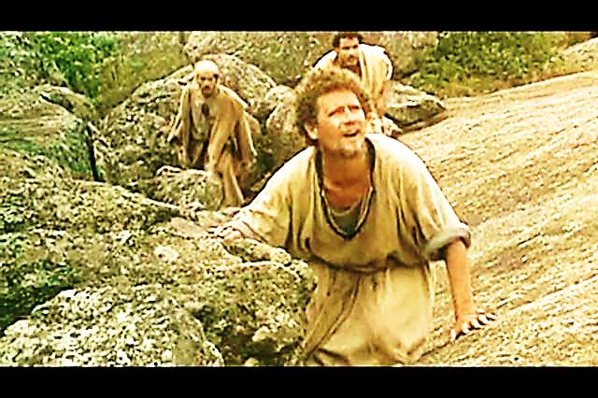
One day Jesus gives his disciples an opportunity to really see what kind of man He is: Matthew 17:1-9

Slide 18
Next Slide - Video:
Transfiguration →
Download Here:
http://youtu.be/h-FKQLhqMC0

Slide 19
The Final Word – He is no mere man

Slide 20
Next Slide - Video:
Matthew 8:51→
Download Here:
http://youtu.be/Uxy_rWR9llA

Slide 21
Next Slide - Song:
He is the Great I AM→
Download Here:
http://youtu.be/MxxIYMzje9E

Slide 22
Next Slide - Song:
Mary Did You Know→
Download Here:
http://youtu.be/_U2G8wsbXBo

Slide 23
Is Jesus Speaking to You?
“They said to each other, ‘Did not our hearts burn within us while he talked to us on the road, while he opened to us the Scriptures?’”
John Wesley Said:
“…the preacher was describing the change which God works in the heart through faith in Christ and I felt my heart strangely warmed.”
Jesus makes His presence Known by a small voice!

Slide 25
What is the Sinner‘s Prayer?
This is a prayer we can pray when we are ready to admit we are sinners and need Christ’s forgiveness.
It must be prayed with faith in our hearts and a readiness to have a life-changing encounter with Jesus Christ.

Slide 26
A prayer of faith → Pray this prayer if :
If you never have before
You have in the past, but you think it would mean more today
You have been walking afar off and you want to come back
You want to set an example & show others how it is done
You just like to give your heart to Jesus again & again
Faith

Slide 27
We Declare Our Faith Publicly Because Jesus Declared His LOVE Publicly
“If you stand before others and are willing to say you believe in me, then I will tell my Father in heaven that you belong to me.” Mat 10:32

Slide 28
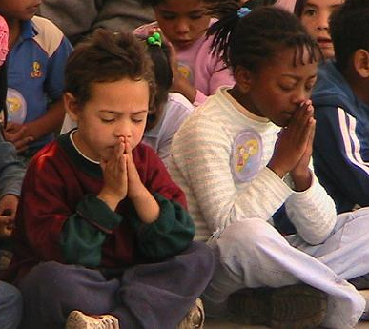
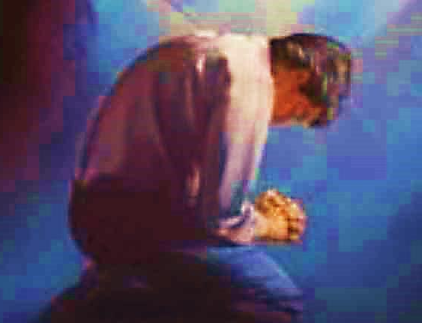
Important Questions
Do you want to know Jesus as your Savior right now?
Do you believe He died to save you from your sins & that He rose from the dead?
Do you believe that He is here, waiting to save you right now?

Slide 29
The Prayer of a Sinner Turning to Jesus
Dear Jesus, I know that I have sinned against You and that my sins separate me from You.
I am truly sorry.
Right now, I turn away from my sinful past .
Please forgive me, and help me to keep from sin.
I believe You died for my sins.
I Believe You rose from the dead, you are alive, and you hear this prayer from my heart.
I invite You Jesus to be both my Savior and the Lord of my life.
I want You to rule my life from now on.

Slide 30
“But some people did accept him. They believed in him, and he gave them the right to become children of God.”
John 1:12

Slide 32
“If you openly say, ‘Jesus is Lord’ and believe in your heart that God raised him from death, you will be saved.”
Rom. 10:9
What did you learn today?
What is the meaning of the name-tag?
What have you been thinking about God lately?
What do you want to tell the world about Jesus?

Slide 33
“Draw near to God, and He will draw near to you…
Altar Time
…Cleanse your hands, you sinners, and make your hearts pure, you who are half-hearted towards God.” James 4:8 WNT

Slide 34
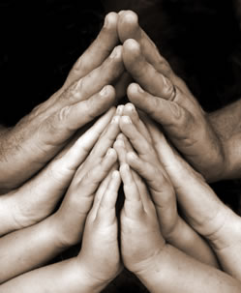
Close in Prayer

Slide 35
Note: Any videos in this presentation will only play online. After you download the slideshow, you will need to also download the videos from YouTube & add them back into your PowerPoint.
We present these messages at Bee Creek Park in College Station, TX. If you would like to watch the video of the service with this message, click here:
http://campaignkerusso.org/?p=11349
We would love to know more about the people who download our lessons & sermons. We invite you to email us & let us know where & how you use them.
info@ckbrazos.org

Slide 36
Welcome to Aggieland Faith Family Style Worship

Slide 37
CURRENT SCHEDULE: See www.Aggielandfaith.org
Three Sunday Services
First Sunday Service:
Basics – 15-20 min.
Includes – Snacks, Crafts, Prizes & Bible
We are going through the New Testament
Second Sunday Service:
Middle Level – 20-30 min.
Includes – Snacks, Prizes & Bible
We are going through the Old Testament
Third Sunday Service:
Advanced – 30-40 min.
Includes – Snacks, Prizes & Bible
We are studying the Tabernacle

Slide 38
Would You Like Prayer or Bible Study at Your House?
Personal Prayer: We can come to your home & pray with you, or you can email us when you need prayer.
Home Bible Study: We will come to your home & hold a bible study for you & your friends.
Bible Party: We will hold a Kid’s Bible Party: You provide the food & kids - we will do the bible fun & stories.

Slide 39
Would You Like Visitation?
We will visit a friend, loved one in the hospital or in prison to pray for them & share Christ with them.
Contact: info@aggielandfaith.org

Slide 40
www.aggielandfaith.org
Go here to see pictures & videos
Go here to subscribe to e-mails about changes & cancellations

Slide 41
Note: Any videos in this presentation will only play online. After you download the slideshow, you will need to also download the videos from YouTube & add them back into your PowerPoint.
We present these messages at Bee Creek Park in College Station, TX. If you would like to watch the video of the service with this message, click here:
http://campaignkerusso.org/?p=11349
We would love to know more about the people who download our lessons & sermons. We invite you to email us & let us know where & how you use them.
info@ckbrazos.org

